Slide 1
The city of Larissa
Hosty and cozy...

Slide 2
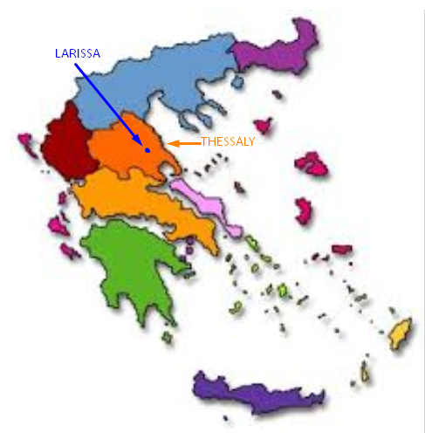
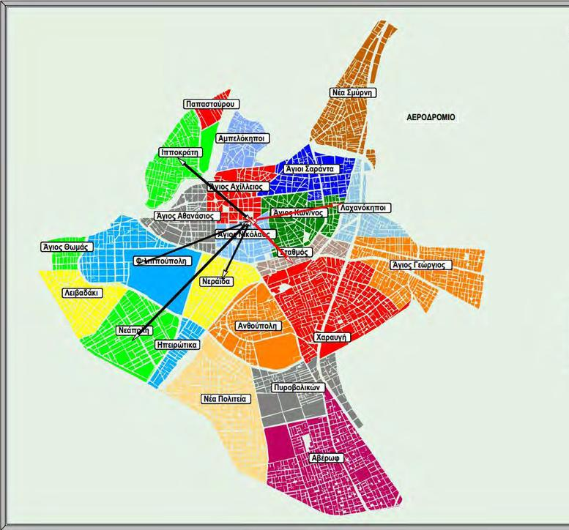
Larissa, is the biggest city of the Thessaly region and the central administration of Thessaly - central Greece

Slide 3
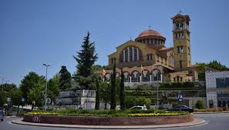
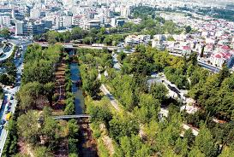
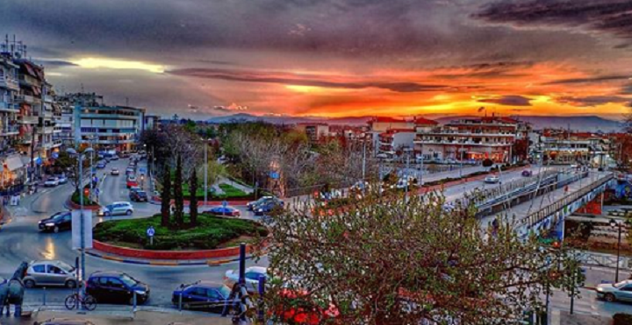
The city of Larissa lies on the banks of the river Pinios, in the center of the eastern part of the Thessalian plain.
The altitude of the city is 80 meters above sea level. It lies on feet of the mountains Ossa (1972 m.) and Olympus (2,918 m.)

Slide 4
The history of the city

Slide 5
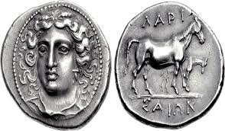
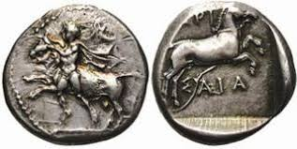
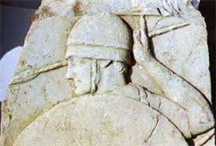
The name Larissa is prehellenic, of pelasgian origin
It means ‘acropole’ or ‘fortressed hill’.
According to a myth it was built by Larisos, son of Pelasgus.
Another myth says that nymphe Larisa, while playing with a ball on the riverside of Pinios, slept in and drowned, thus giving her name to the city
The city has been continuously inhabited since the Neolithic era and is probably one of the oldest cities in the world with a continuous inhabitation of at least 8,000 years.

Slide 6
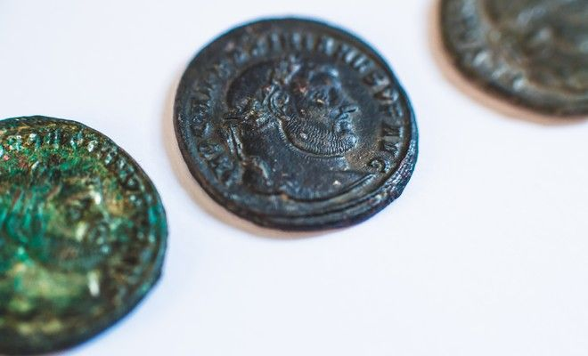
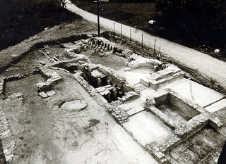
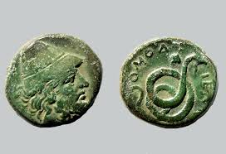
Roman Era
In 197 BC. the Romans occupied the city that had a brief period of prosperity.

Slide 7
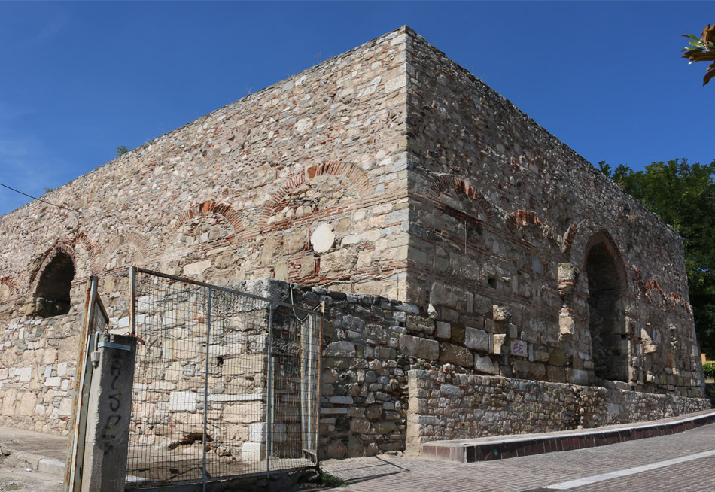
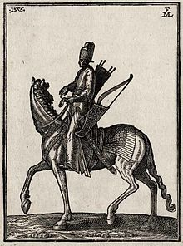
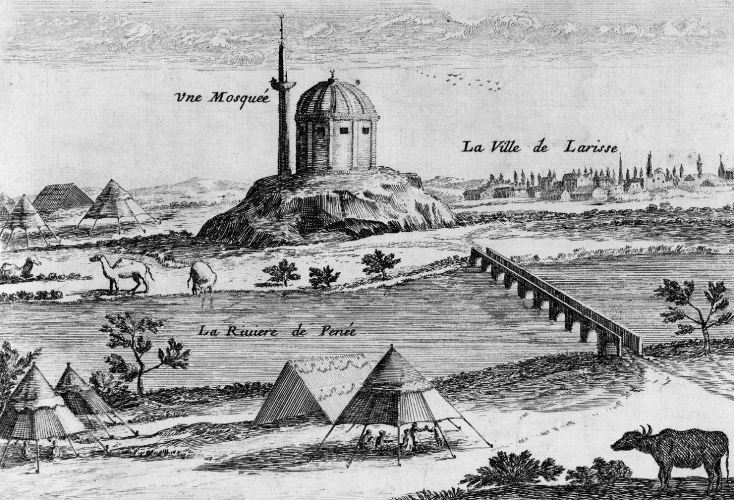
Ottoman Era
The city bore the name Yeni Şehir Feneri A large part of the population moved to the mountains for greater security, away from Ottoman rule.
In 1881 Thessaly was liberated by the Greek army and Larissa was annexed to the Greek state.

Slide 8
Education in Larissa

Slide 9
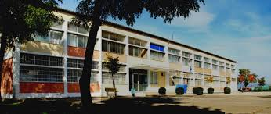
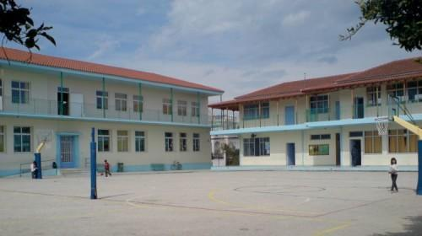
School Units
Kindergartens, Primary Schools, Gymnasiums, Music high school, Day and Evening High Schools, Vocational High Schools.
Also operating:
kindergartens and public schools for children with special needs and children with diffuse developmental disorders

Slide 10
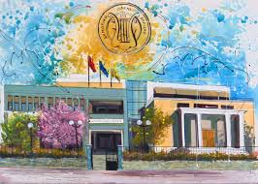
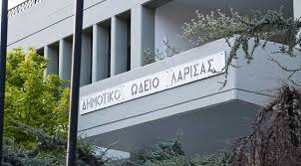
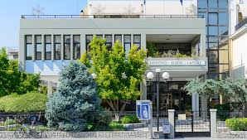
Municipal Conservatory
It was founded on 1930

Slide 11
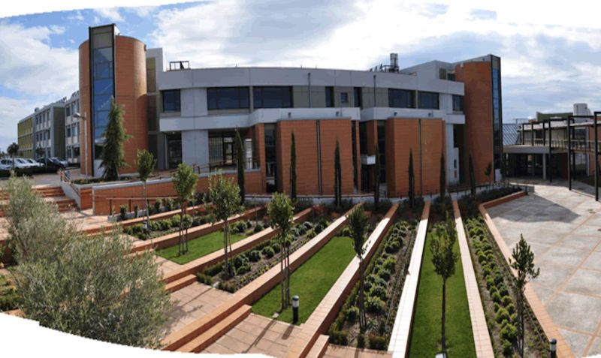
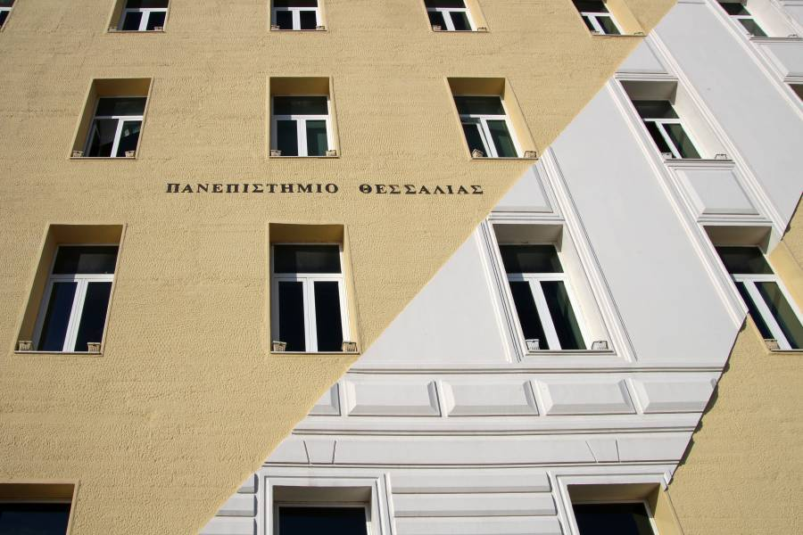
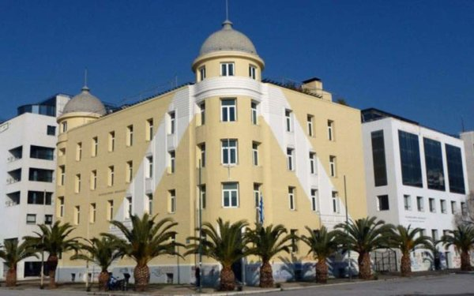
University of Thessaly
There are 3 faculties and 10 departments of the University of Thessaly in the city: Medicine, Biochemistry - Biotechnology, Nursing ( School of Health Sciences), Agriculture, Agrotechnology, Animal Production ( School of Agricultural Sciences), Accounting and Finance, Accounting and Finance and Energy Systems, Environment, Digital Systems (School of Technology)

Slide 12
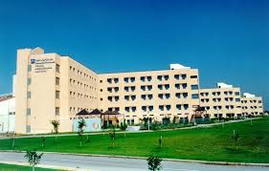
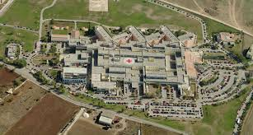
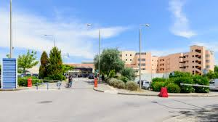
University Hospital
Τhe university clinics, laboratories and special units of the medical department of the School of Health Sciences of the University of Thessaly are established there.

Slide 13
Archaeological Sites in Larissa

Slide 14
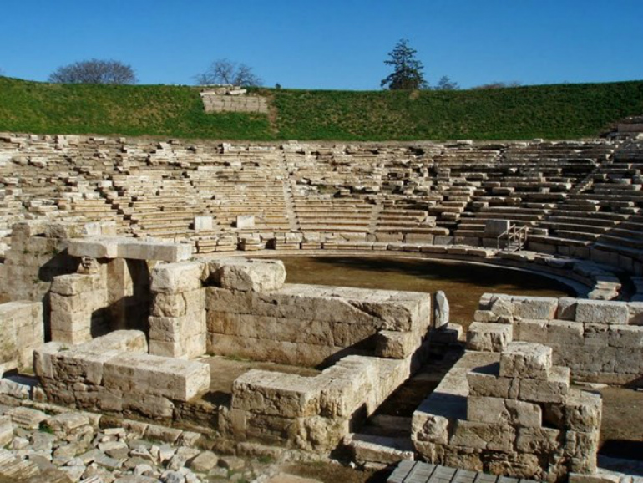
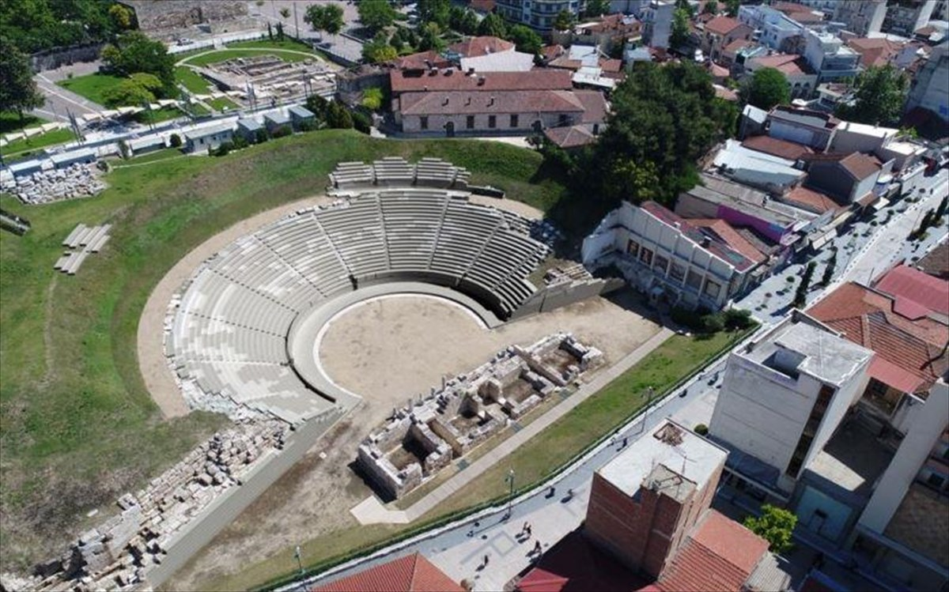
First Ancient Theater
Built in the 3rd century BC, on the south side of the Fortress hill. During the Roman period, it was transformed into an arena. For centuries it layed under houses and stores. Excavations brought it to the surface in the mid-1990s.
It is estimated to have a capacity of about 12,000 spectators.

Slide 15
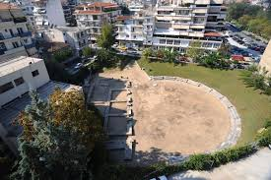
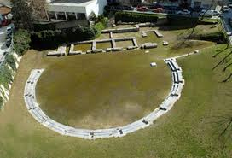
2nd Ancient Theater
This is the theater that replaced the AD Ancient theater during the Roman period. It was discovered in 1978 during an excavation for the construction of a building.

Slide 16
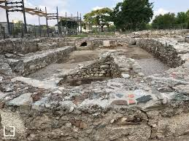
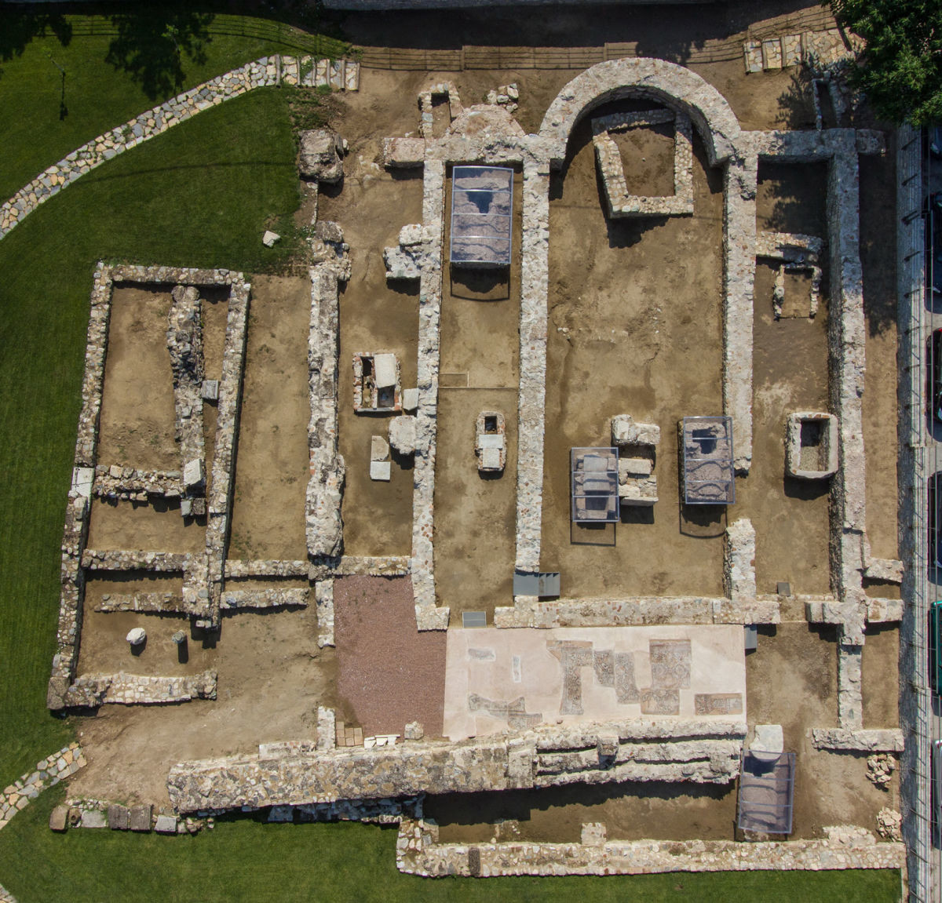
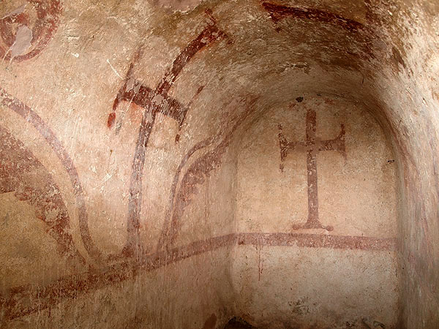
Basilica of Saint Achilles
This basilica is located on the hill of the Fortress. It is probably the first church in the city, dedicated to the patron saint Agios Achilleios, the first archbishop of the city. It was built in the 6th AD. century, over the tomb of Saint Achilles. Today we can see only the foundation level. The narthex is decorated with a Byzantine mosaic floor.

Slide 17
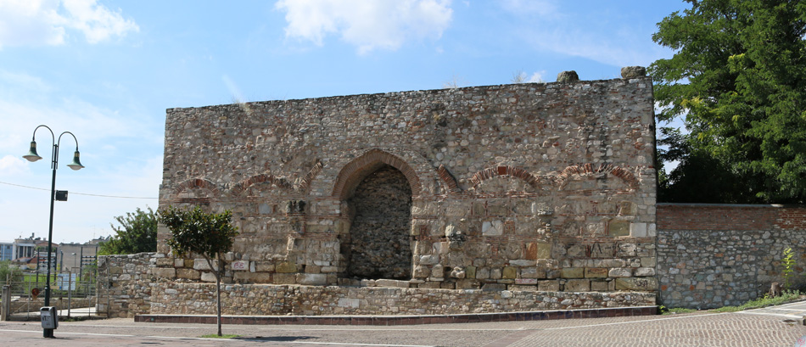
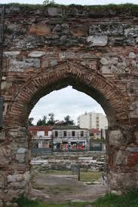
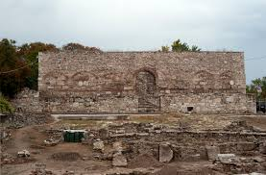
Bezesteni
It rises to the top of the Fortress hill. It was an indoor market of fabrics (bez) and valuable goods. For three centuries it was the core of the city's economic activity.
In 1799 it was destroyed by fire. During the 19th c. it was used as powder keg and Fortress.

Slide 18
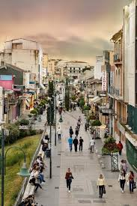
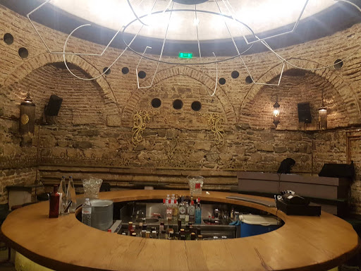
Ottoman Baths
I was built in the 15th century. Today, the most prominent element of the Hammam is its dome, and its interior, which served as a locker room, is now used by laboratories and modern shops.
Despite the various renovations that have taken place in the past, the baths preserve many authentic architectural elements. It is located at the corner of Venizelou and Philellinon streets.

Slide 19
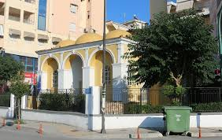
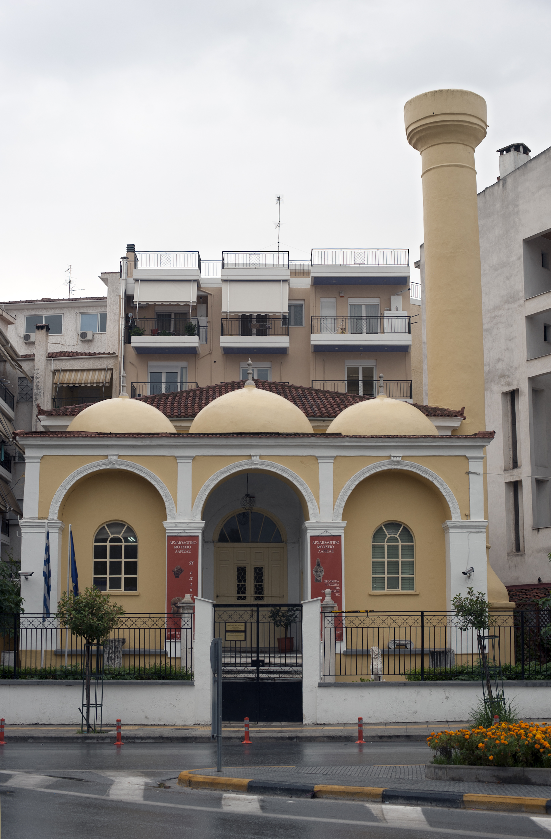
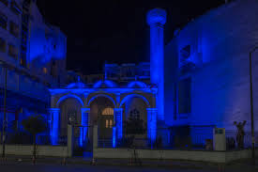
Yeni Mosque
Mosque dating to the late 19th - early 20th century. It was used as a mosque until 1924. It is located in the center of modern Larissa, on 31st of August Street.

Slide 20
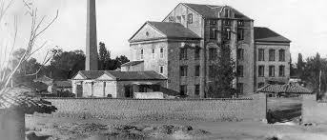
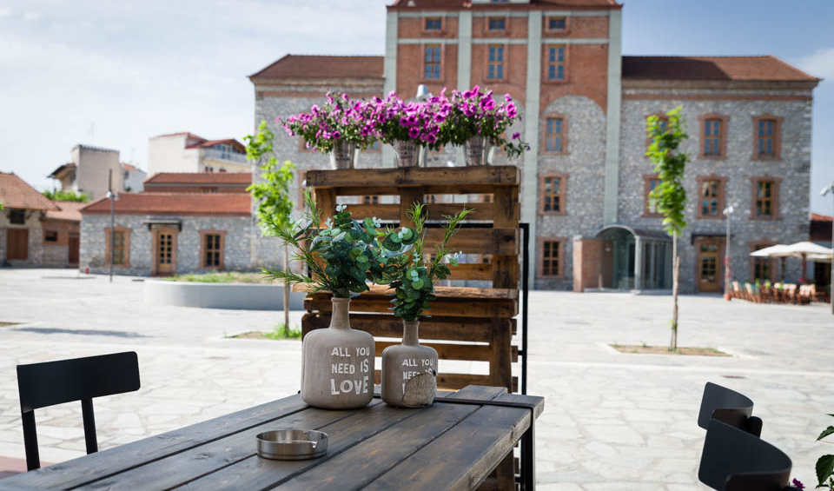
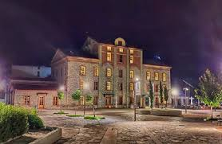
Pappas’ Mill
Pappas’ Mill is a building complex located on Georgiadou Street, behind the ‘hill of the Fortress’. It is an industrial flour-making building established in 1883. It was reconstructed twice after fires and was the most characteristic industrial building in the wider area of Thessaly.
Today, Pappas’ Mill is a multifaceted cultural, educational, entertainment and conference center. It hosts the performances of the Thessalian Theater, the Municipal Philharmonic orchestra, the Puppet Museum, the Primary School of Ballet, the summer cinema and a Music Stage and the Museum of Wheat and Flour.

Slide 21
Museums

Slide 22
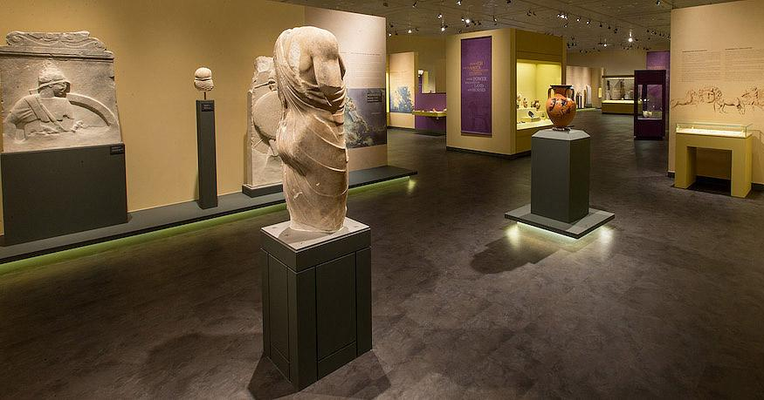
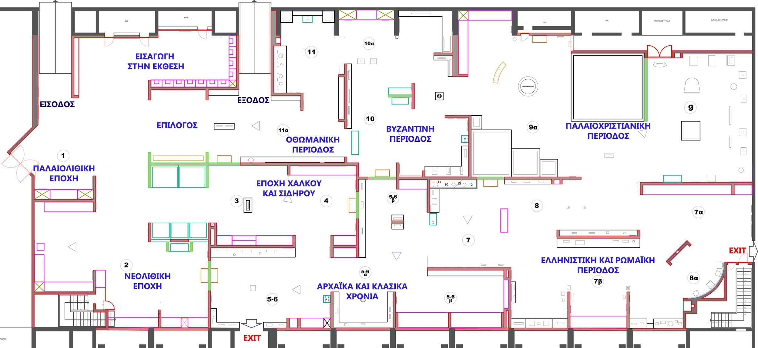
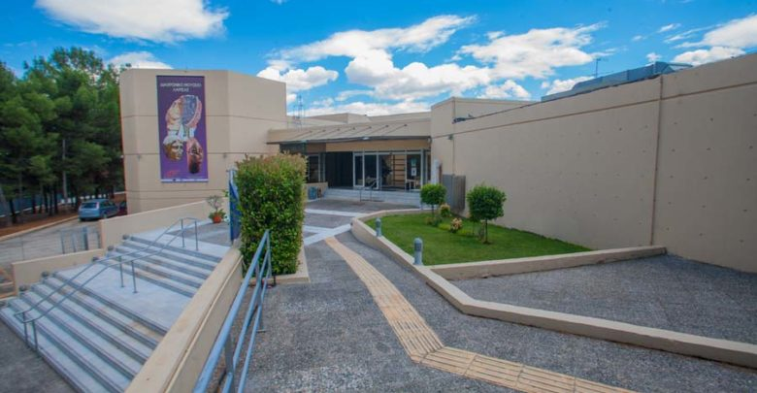
Diachronic Museum
The exhibits come from excavations (carried out during the 20th century and until today in Thessaly), from donations of objects as well as from repatriation of antiquities.

Slide 23
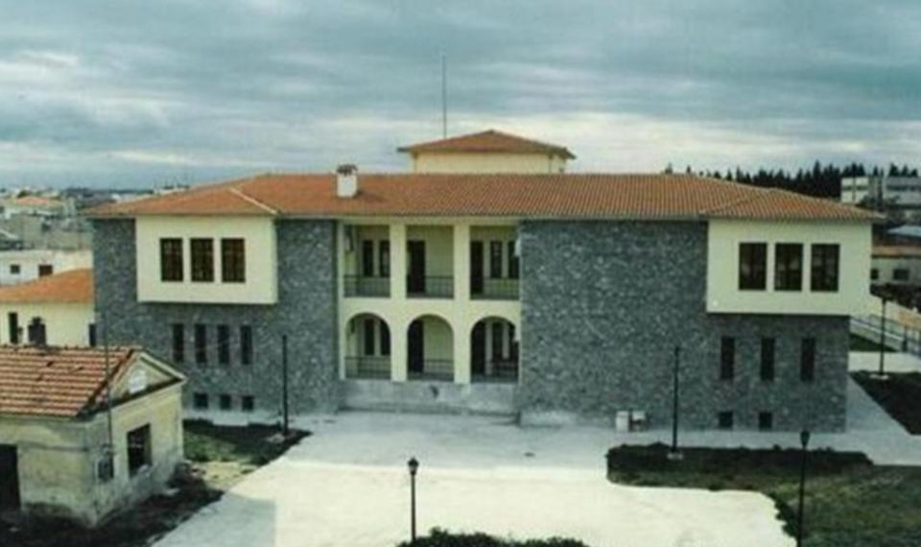
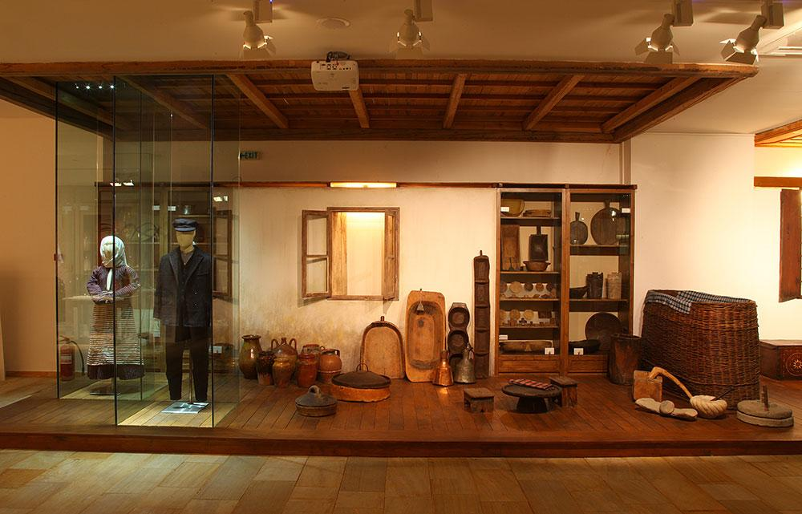
Ethnographic Historical Museum
The Museum's collections include objects of traditional techniques, tools of traditional professions, products of ceramics, coppersmithing, weaving, embroidery, woodwork-wood carving, secular and ecclesiastical silversmithing.

Slide 24
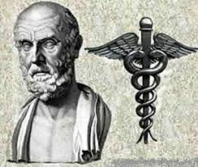
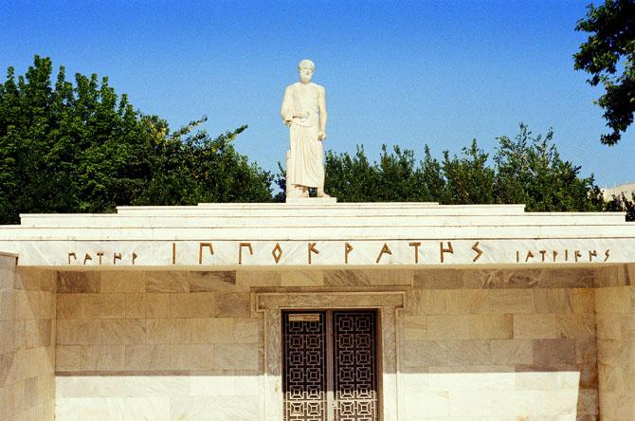
Museum of Hippocrates
Hippocrates was the greatest doctor known to the ancient world and father of Medical Science. His burial monument is in Larissa. It was discovered accidentally, after a flood of Pinios in 1826

Slide 25
Museum of the National Resistance
The Museum of National Resistance is housed in a building from the 18th century that was used as prison, on Ioustinianou Street.
The objects of the exhibition concern the period of the Greek-Italian war, the Occupation and the National Resistance (1940 - 1944).

Slide 26
Museum of Cereals and Flour
A modern museum that is linked with the memories and the life of this place, created in the Mill of Pappas. The subject is the golden cereal, the wheat, which has been produced for hundreds of years in the land of Thessaly.

Slide 27
Municipal Art Gallery
The Municipal Gallery of Larissa - GI Museum Katsigra was founded in 1983, when the doctor and collector Georgios I. Katsigras donated his Collection to the Municipality of Larissa. The Katsigras Collection includes 780 works - paintings, engravings and drawings - from the 19th to the middle of the 20th century.

Slide 28
Saint Achilles
Is located on the Fortress hill, at the highest place of the city and has view to the park of Alcazar and the Pinios river that crosses the city. It is the most important pilgrimage of our city as it hosts the relics of Saint Achilles. His memory is celebrated with the greatest formality on May 15th.

Slide 29
Squares and Parks

Slide 30
Central square
Post’s Square
Prefecture Square

Slide 31
People's Square
Fortress Square

Slide 32
Park of Alcazar
Alcazar Park is the largest and most important park in the city. It lies on the banks of the river Pinios. Its name means "Castle" in Arabic. It is a small paradise in the heart of Larissa.

Slide 34
Local Products

Slide 35
Fruits
Approximately 46,778 acres with apple trees are cultivated in Thessaly, 20,456 of them are cultivated in the prefecture of Larissa. Also pears and cherries.

Slide 36
Cotton

Slide 37
Wheat Production

Slide 38
OTHER AGRICULTURAL AND LIVESTOCK PRODUCTS

Slide 40
Nature

Slide 41
Pinios River
Pinios is a river of Thessaly. The springs are located on mount Pindos. Through the Thessalian plain it flows into the Aegean sea.

Slide 42
Thessalian Plain
The Thessalian plain is the biggest in Greece and very fertile .
Because of the plain, Thessaly was one of the few areas in Ancient Greece that could house a large number of cavalry.
The Thessalian cavalry was an important part of the ancient Macedonian army of Philip II and Alexander the Great

Slide 43
Tempi valley
The Tempi valley is formed between the mountains Olympus and Ossa. The valley is 10 km long, while the narrowest point of the formed gorge is 25 meters wide and about 500 meters deep.
The river Pinios flows through the valley and into the Aegean. The valley is the main crossing from Macedonia to Thessaly and for this reason the area was of great importance since ancient times.

Slide 44
Olympus
Olympus is the highest mountain in Greece. According to mythology, the Twelve Olympian Gods lived on the top. It is also the second highest mountain in the Balkans. It is located on the borders of Macedonia and Thessaly and is an area of great biodiversity.

Slide 45
Meteora
Meteora is a complex of dark colored rocks from Psammite. The monasteries of Meteora, which are built on the tops of some of the rocks, are today the second most important monastic complex in Greece, after Mount Athos.

Slide 46
Pelion

Slide 47
By the sea...

Slide 48
Agiokampos-Sotiritsa-Velika

Slide 49
Kokkino Nero
Characteristic of the area is the Thermal Springs.

Slide 50
Stomio
Stomio is a tourist resort that combines mountain and sea, near the Delta of the river Pinios. There lied the ancient city of Evrymenes.

